Slide 1
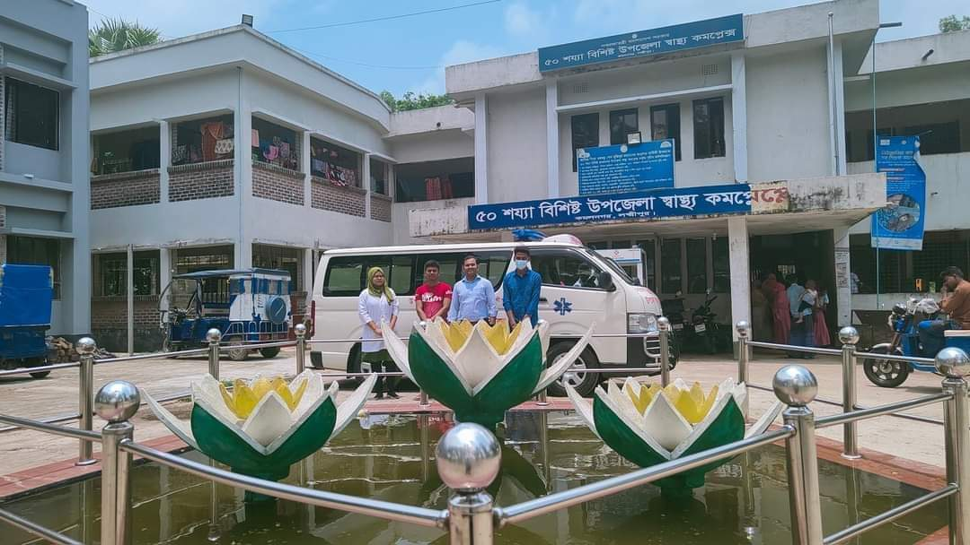
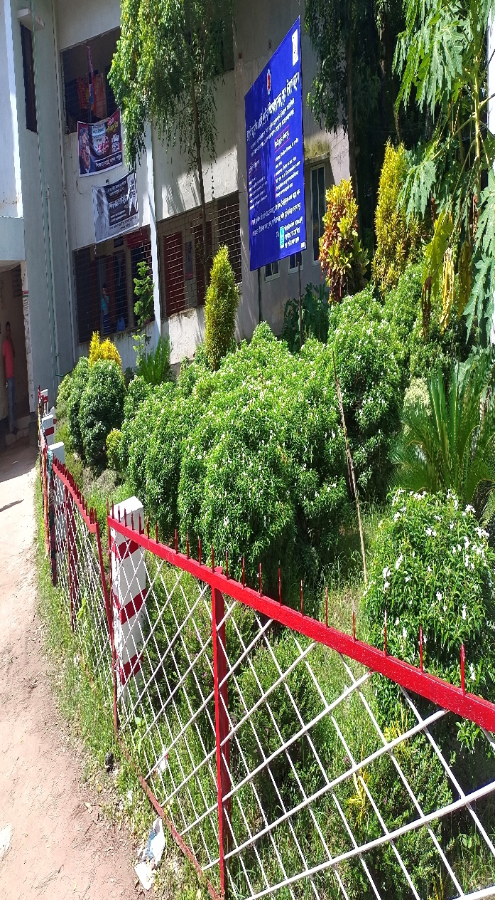
50 BEDED UPAZILA HEALTH COMPLEX
Kamalnagar, Lakshmipur.

Slide 2
A Upazilla Health Complex with a Vision…
Maximum utilization of Govt.
resources with
honesty and sincerity
Integrated approach of
Administration, Community
Leaders & Health
Management
Providing Effective and
prompt services
through improved
management system

Slide 3
Background History of Kamalnagar Upazilla Health Complex, Lakshmipur
To reduce Maternal and Child Mortality and Mobility and to ensure the quality MCH service, UH&FPO opened 9 delivery centre in 9 union with the help of JICA in March 2021 to June-2022. JICA helped by Frontline MCH Program.
4 Special activities:
ANC-Corner
NCD corner
Basic EOC service
Under 5 corner for under 5 children(IMCI)

Slide 4
Contd.
In 2022 Safe Blood Transfusion unit established.
Essential packages for ANC patient started from August 2021.
Women and Child Friendly Hospital declared in 2021.
KMC and SAM corner started from January 2021.
NCD Corner started in …. 2022.
SSK Program started in July 2022.

Slide 5
Health Profile of Kamalnagar UHC- 2022
Total population : 217391
Total Fertile Couples : 34576
Total Pregnant : 1518
Total Delivery : 1737 ?
Total Live birth : 1724 ?
Total death : 13 ?
Total Maternal death : 02 ?
Health Man power
a. Doctor : 19 ( 11 + 8)
b. Nurse : 15
c. HA : 25
d. SBA : ( 2HA+4 FWA + 1CHCP)
e. Volunteer, Security guard & cleaner: 14
9. Health Institutions
a. Health Complex : 01
b. H & FWC : 4 (Sub-2 FWC– 2 )
c. Community clinic : 22
d. Non- Govt. Clinic : 02

Slide 6
10. Mother Taken-ANC : 143% ( 1st Visit)?
11. Hospital Delivery Rate : 84.8% (3755)?
12. No. of Hospital bed : 50
13. Bed Occupancy Rate :108%
14. Maternal Mortality Ratio : 42 / 100000 live Birth?
15. Neonatal Mortality Rate : 16.7 / 1000 live birth?
16. Infant Mortality Rate : 20.6 /1000 live birth?
17. Under-5 Mortality Rate : 22.7 /1000 live birth?

Slide 7

UHC
Bed Occupancy Rate from 2017 to 2022

Slide 8
Emergency & Out Door, Indoor Service 2017 to 2022
UHC

Slide 9
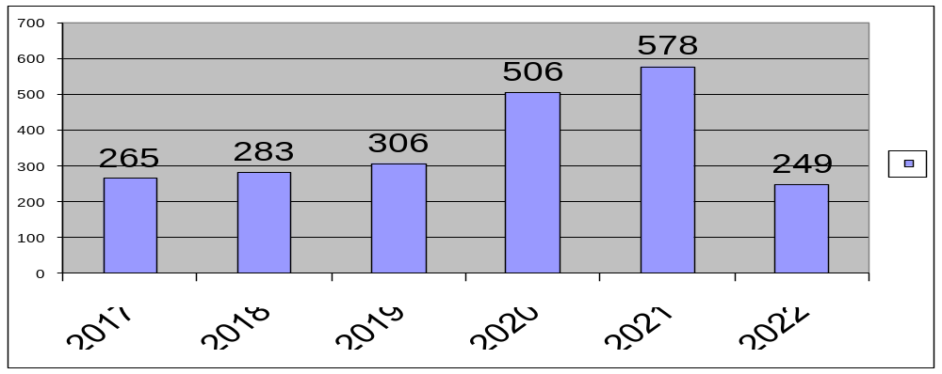
Upazila Health Complex kamalnagar, Lakshmipur.
EOC Activities : 2017 to 2022 (Hospital Delivery )

Slide 10
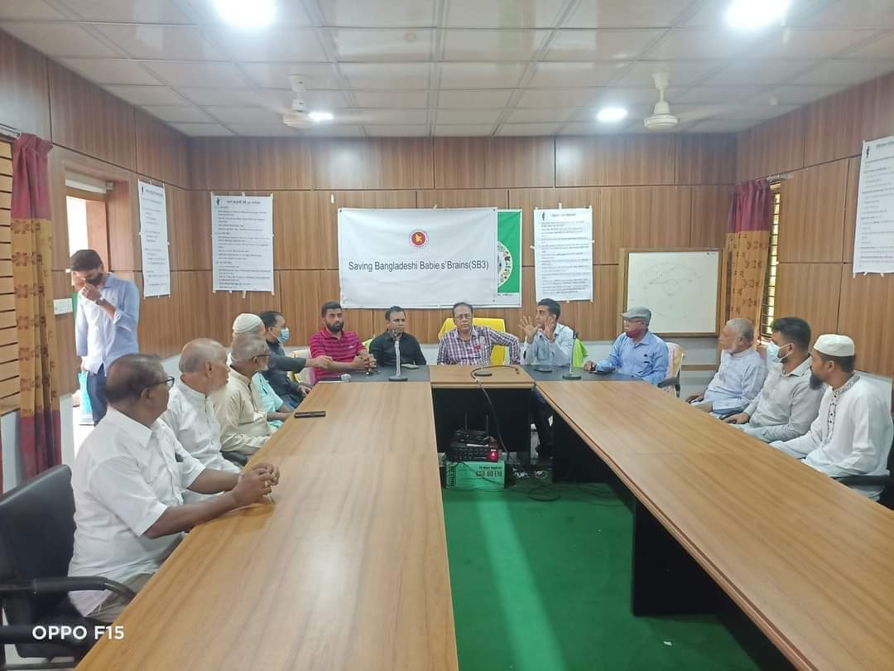
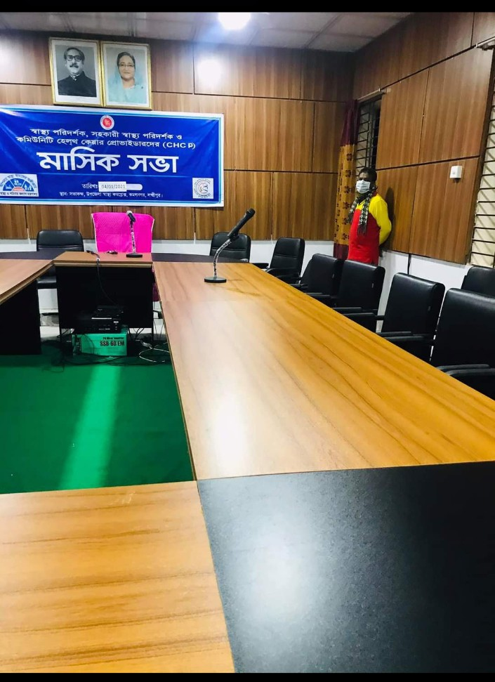
Well-decorated conference room.july 2020

Slide 11
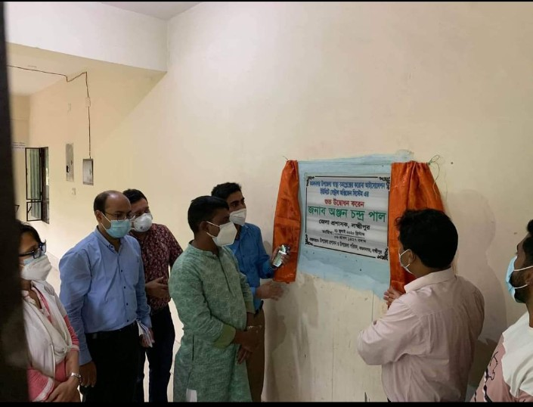
Establishment of Central Oxygen System,July 2020.

Slide 12
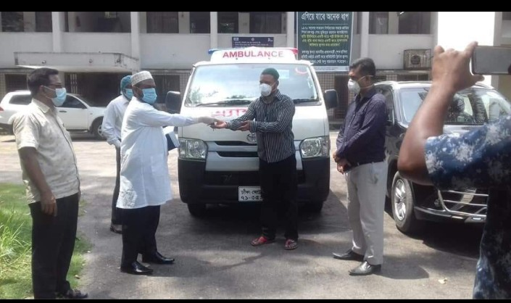
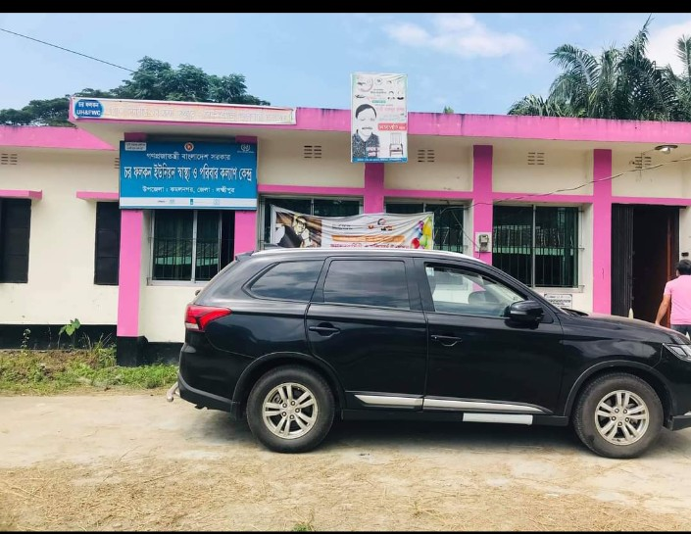
Receiving of Ambulance and Jeep keys from CS Sir ,August 2020.

Slide 13
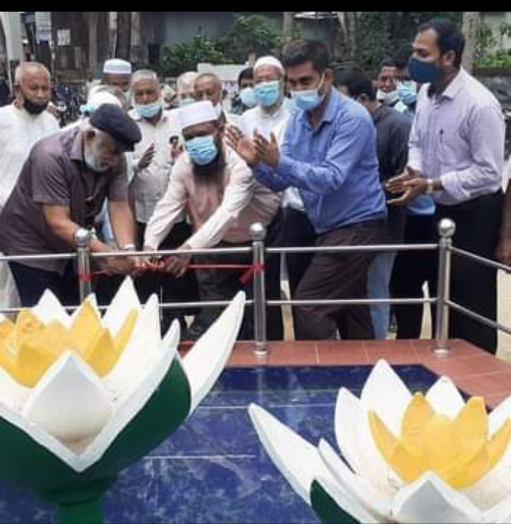
Muktijudda Shapla ChattorInaugurated in2021

Slide 14
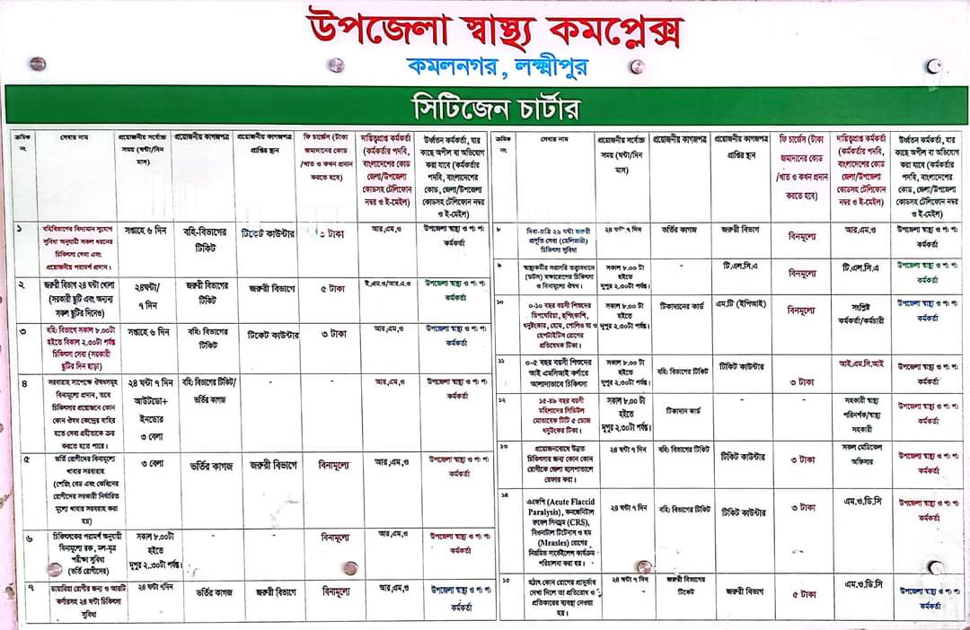
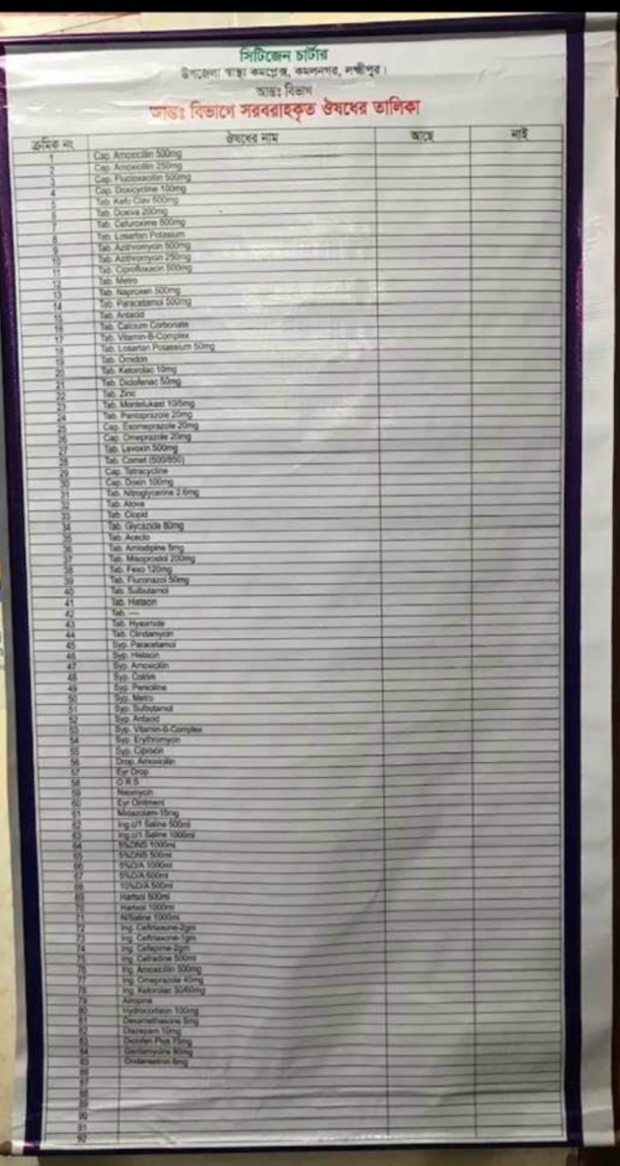
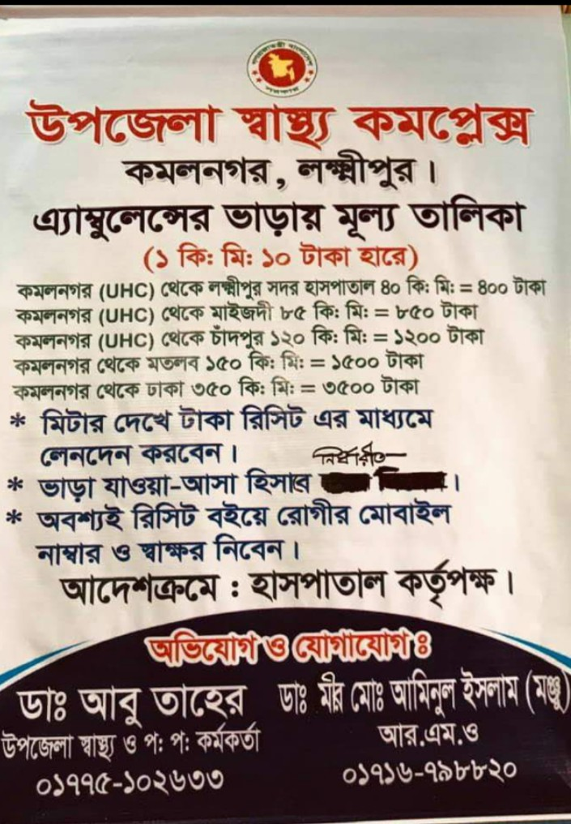
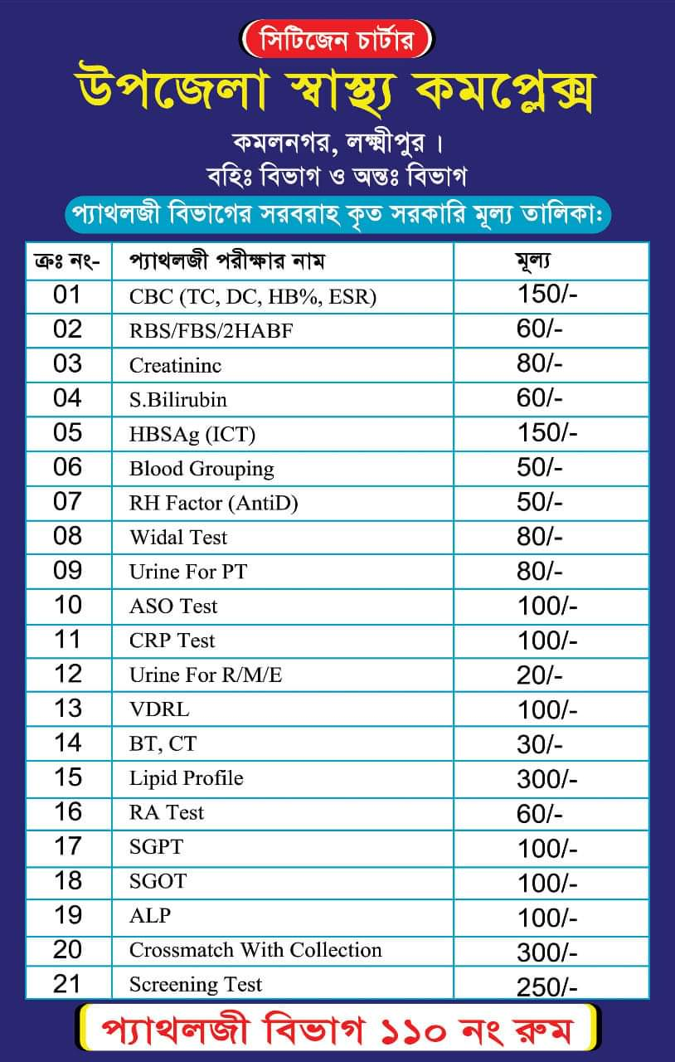
Citizen charter, value and medicine list added 2021

Slide 15
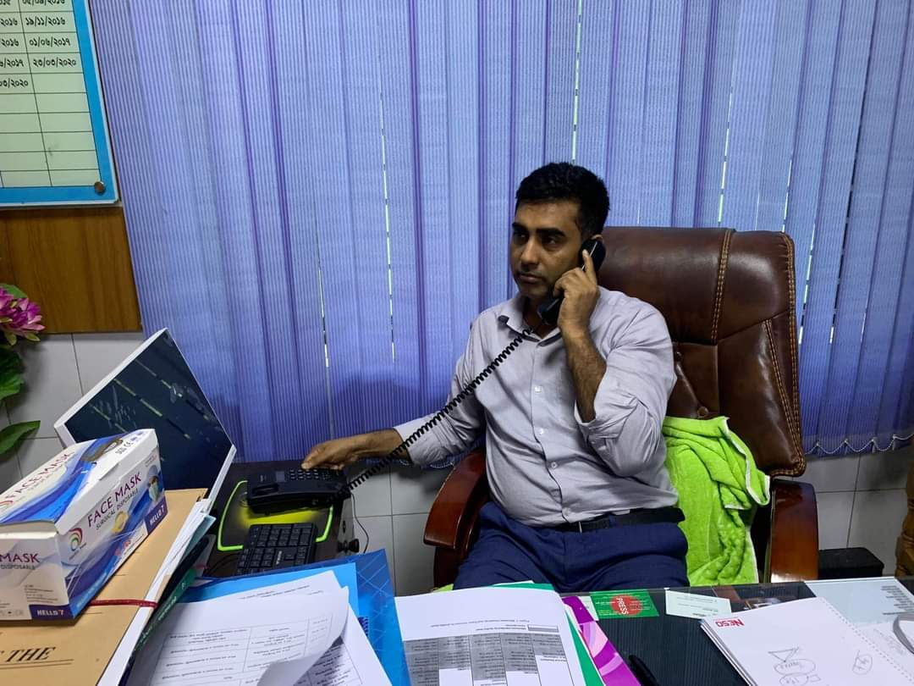
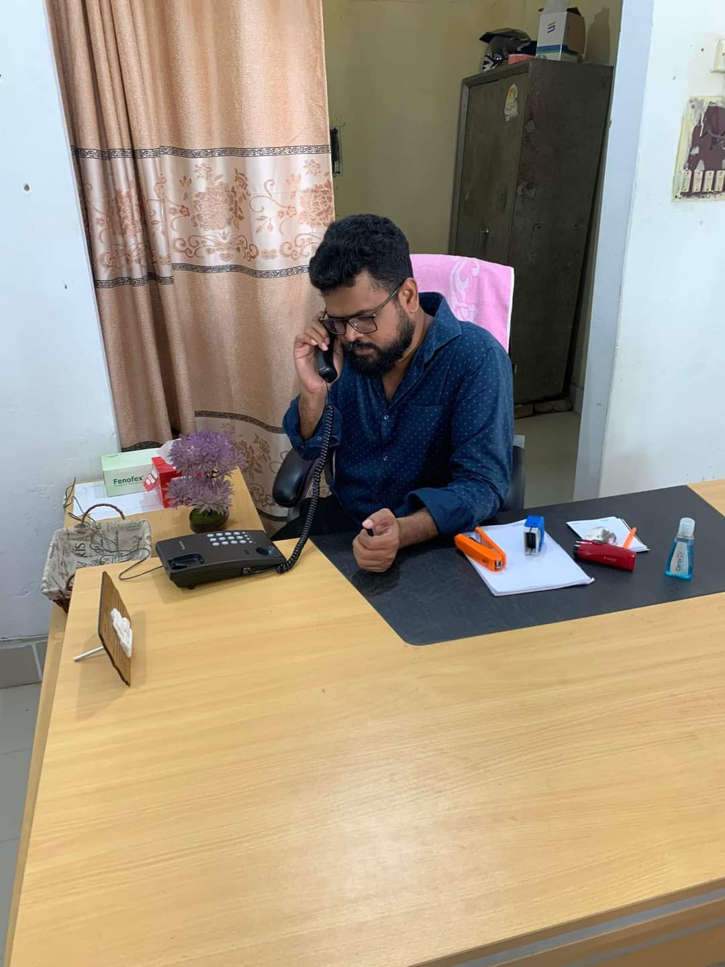
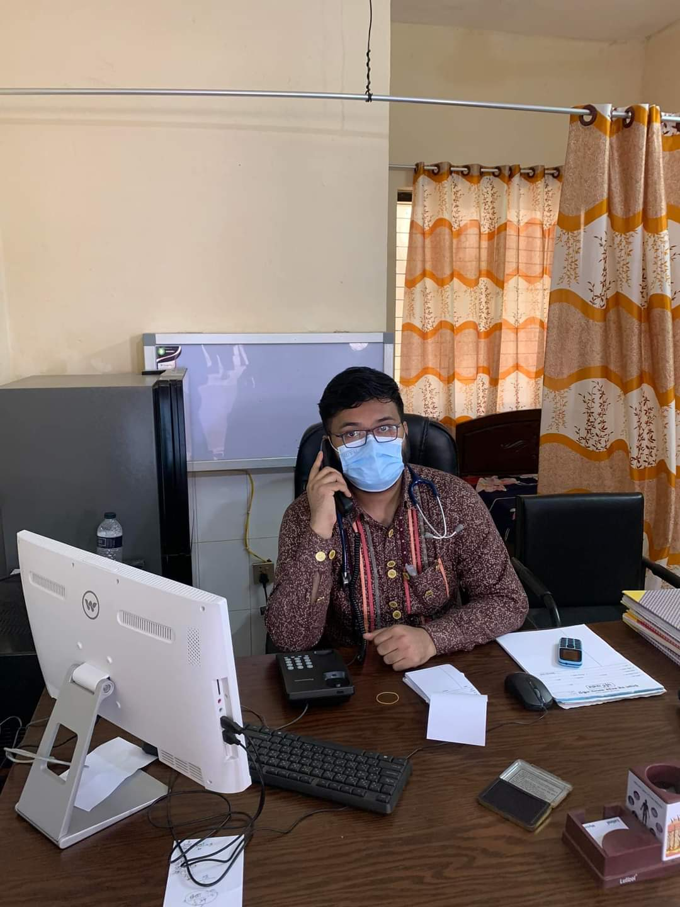
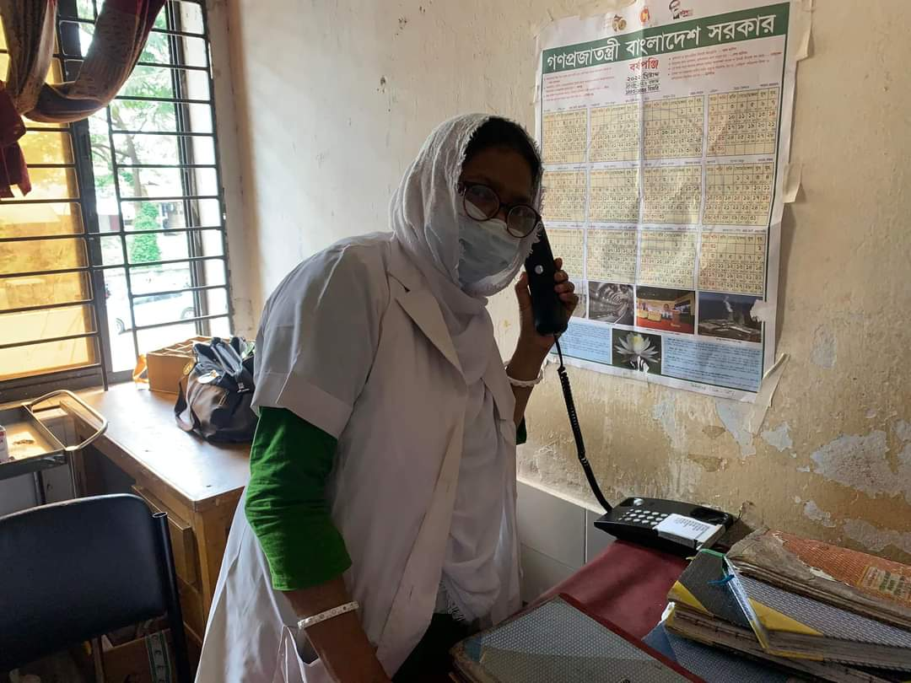
Intercom added march 2022.

Slide 16
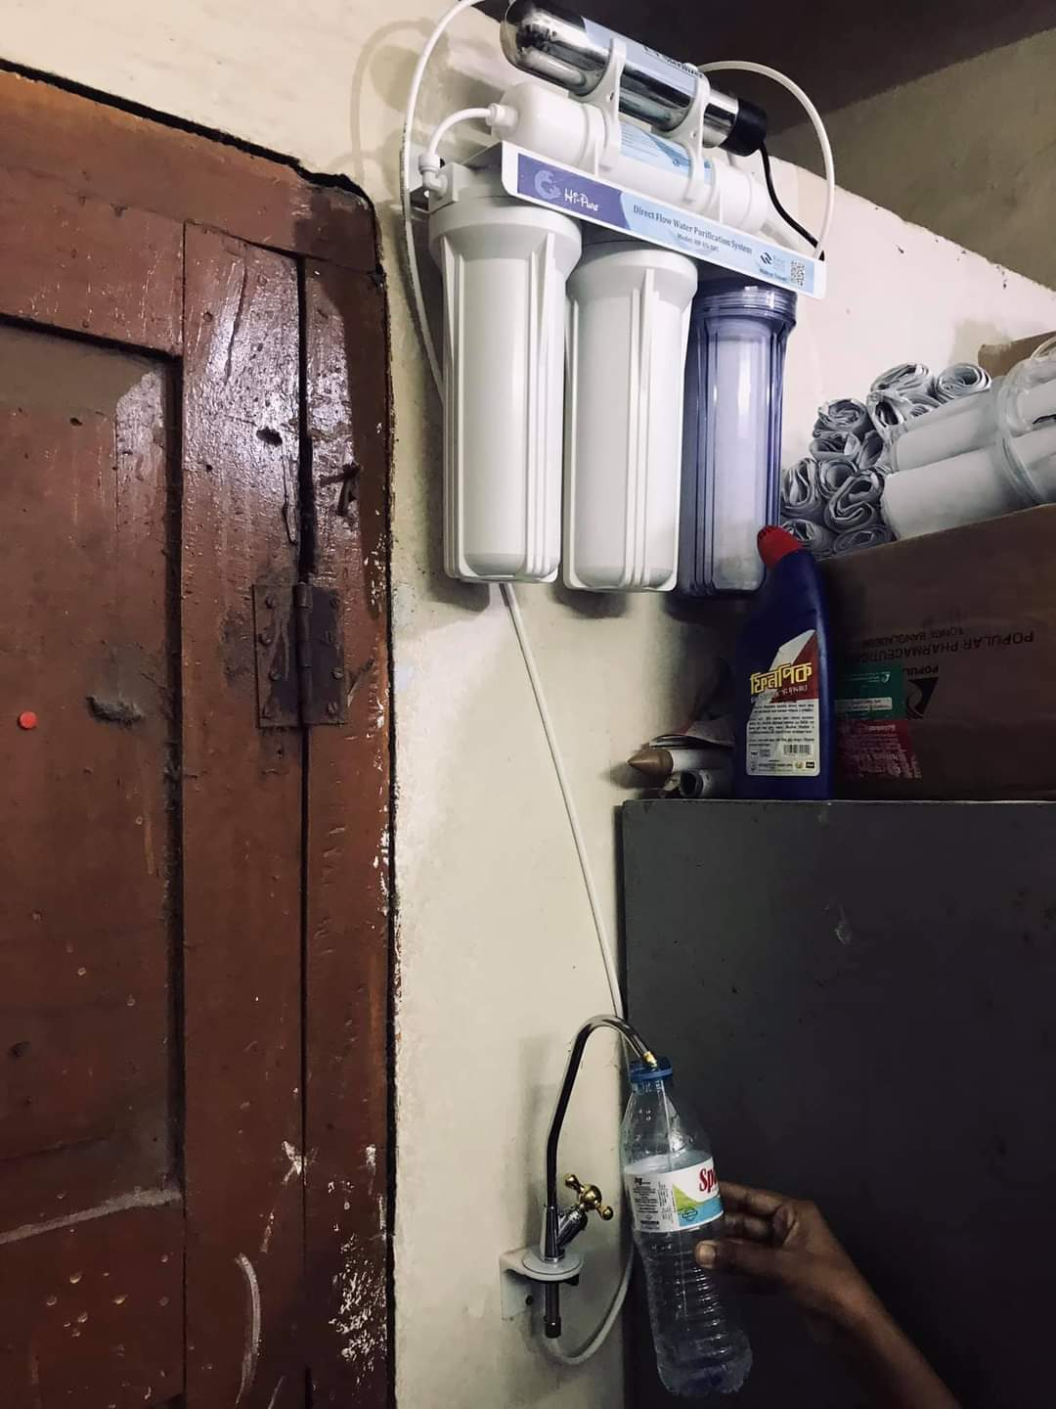
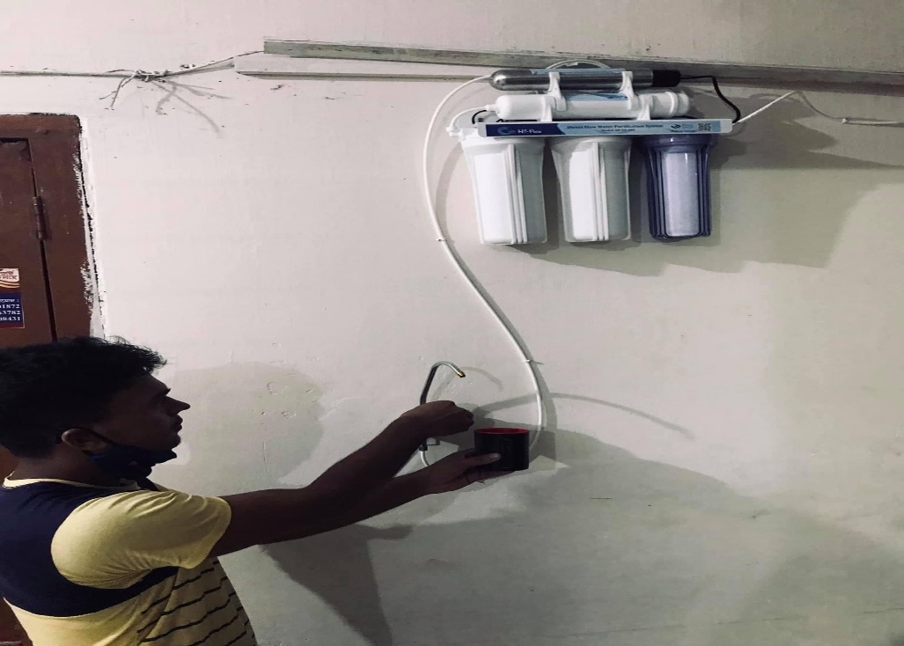
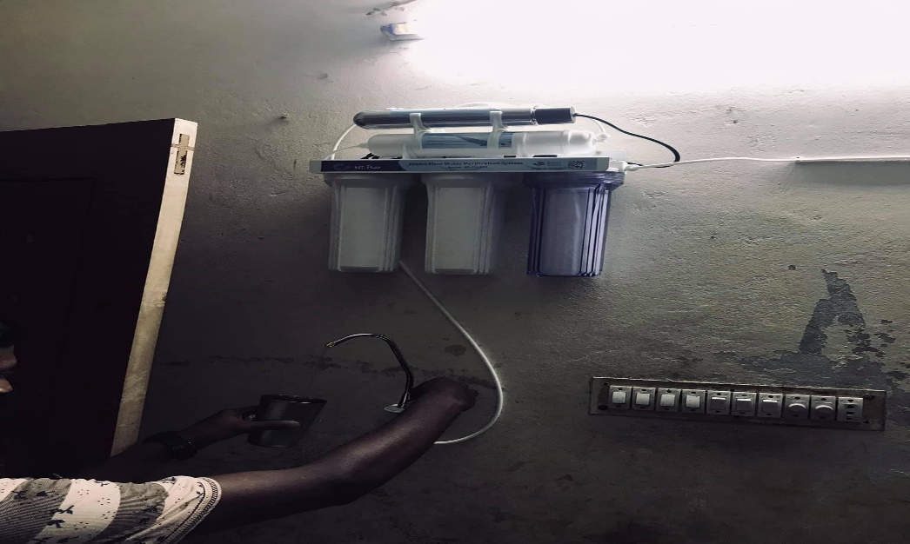
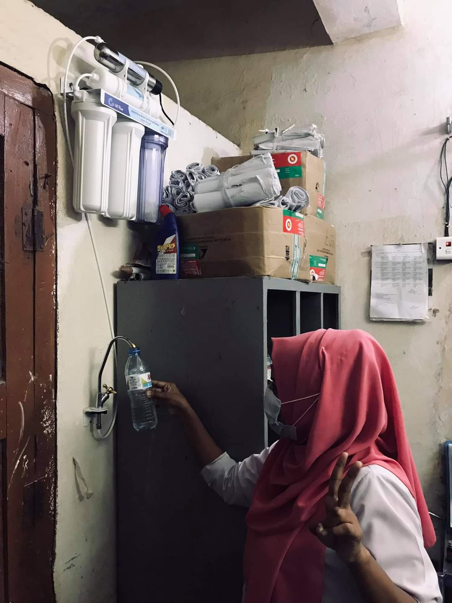
Safe drinking water system added in july 2021

Slide 17
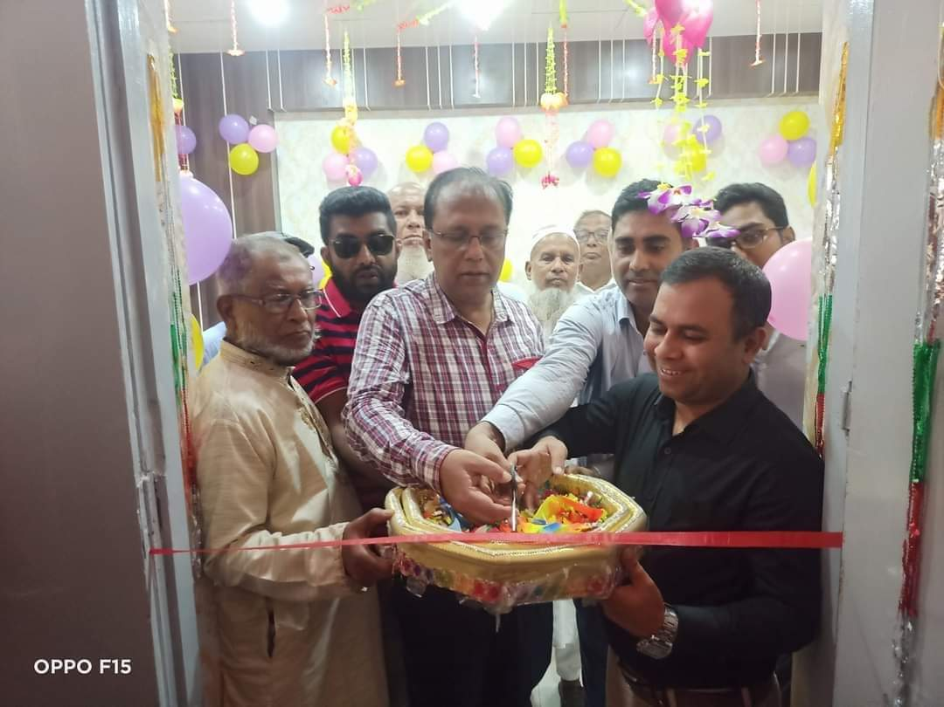
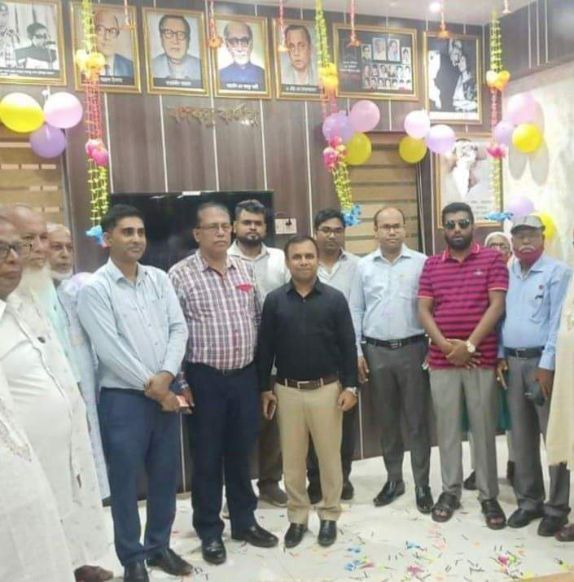
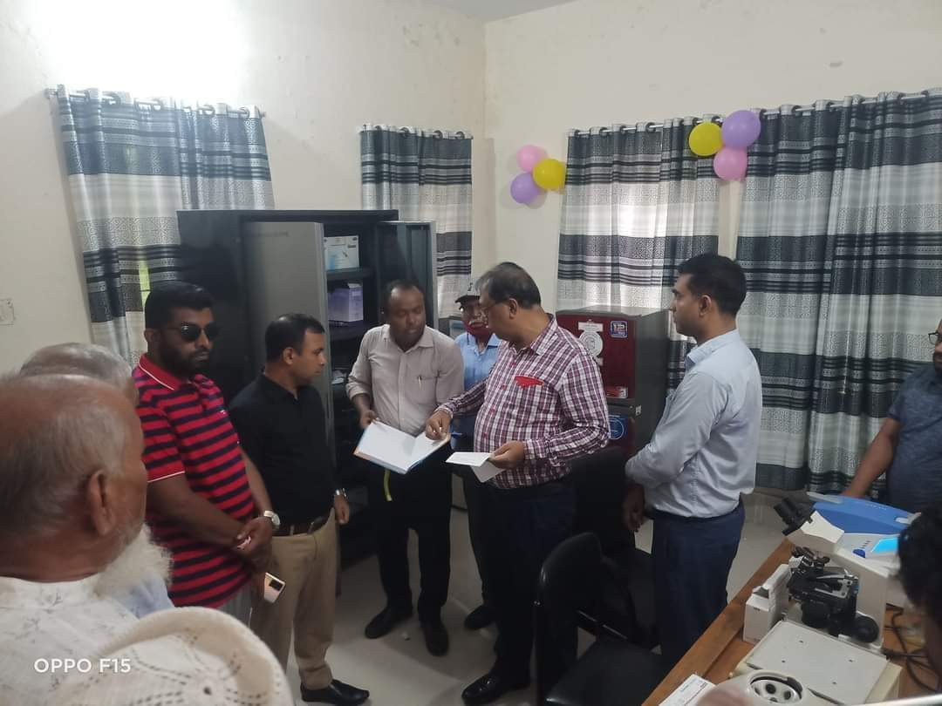
Pathology department, NCD Corner and Banghobondhu Corner

Slide 18
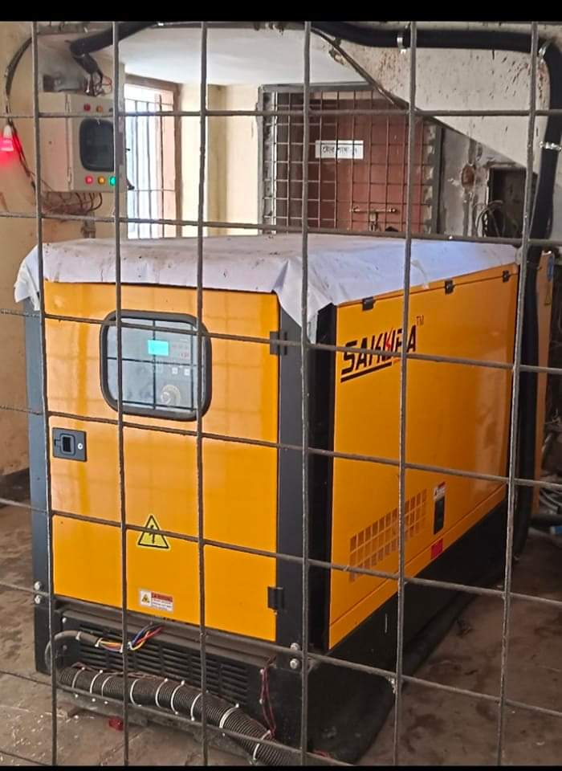
New Generator added june 2022

Slide 19
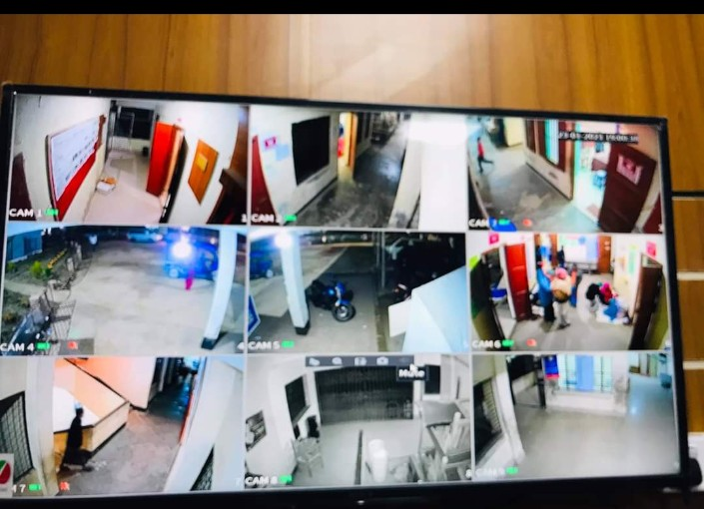
Whole hospital is controlled by CC Cemera added in September 2021.

Slide 20
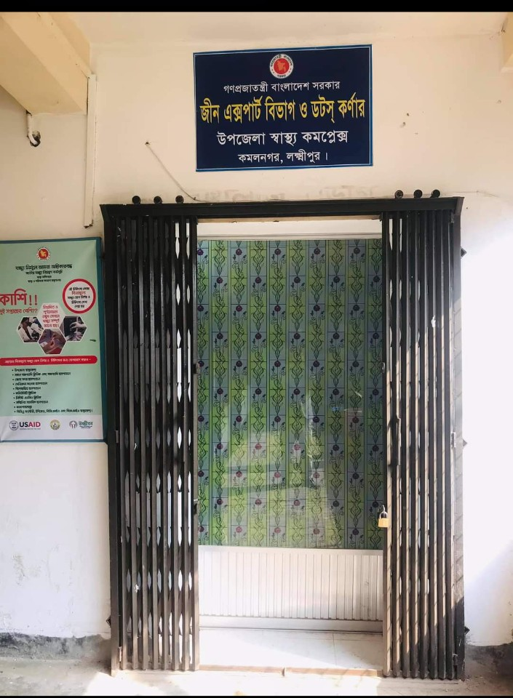
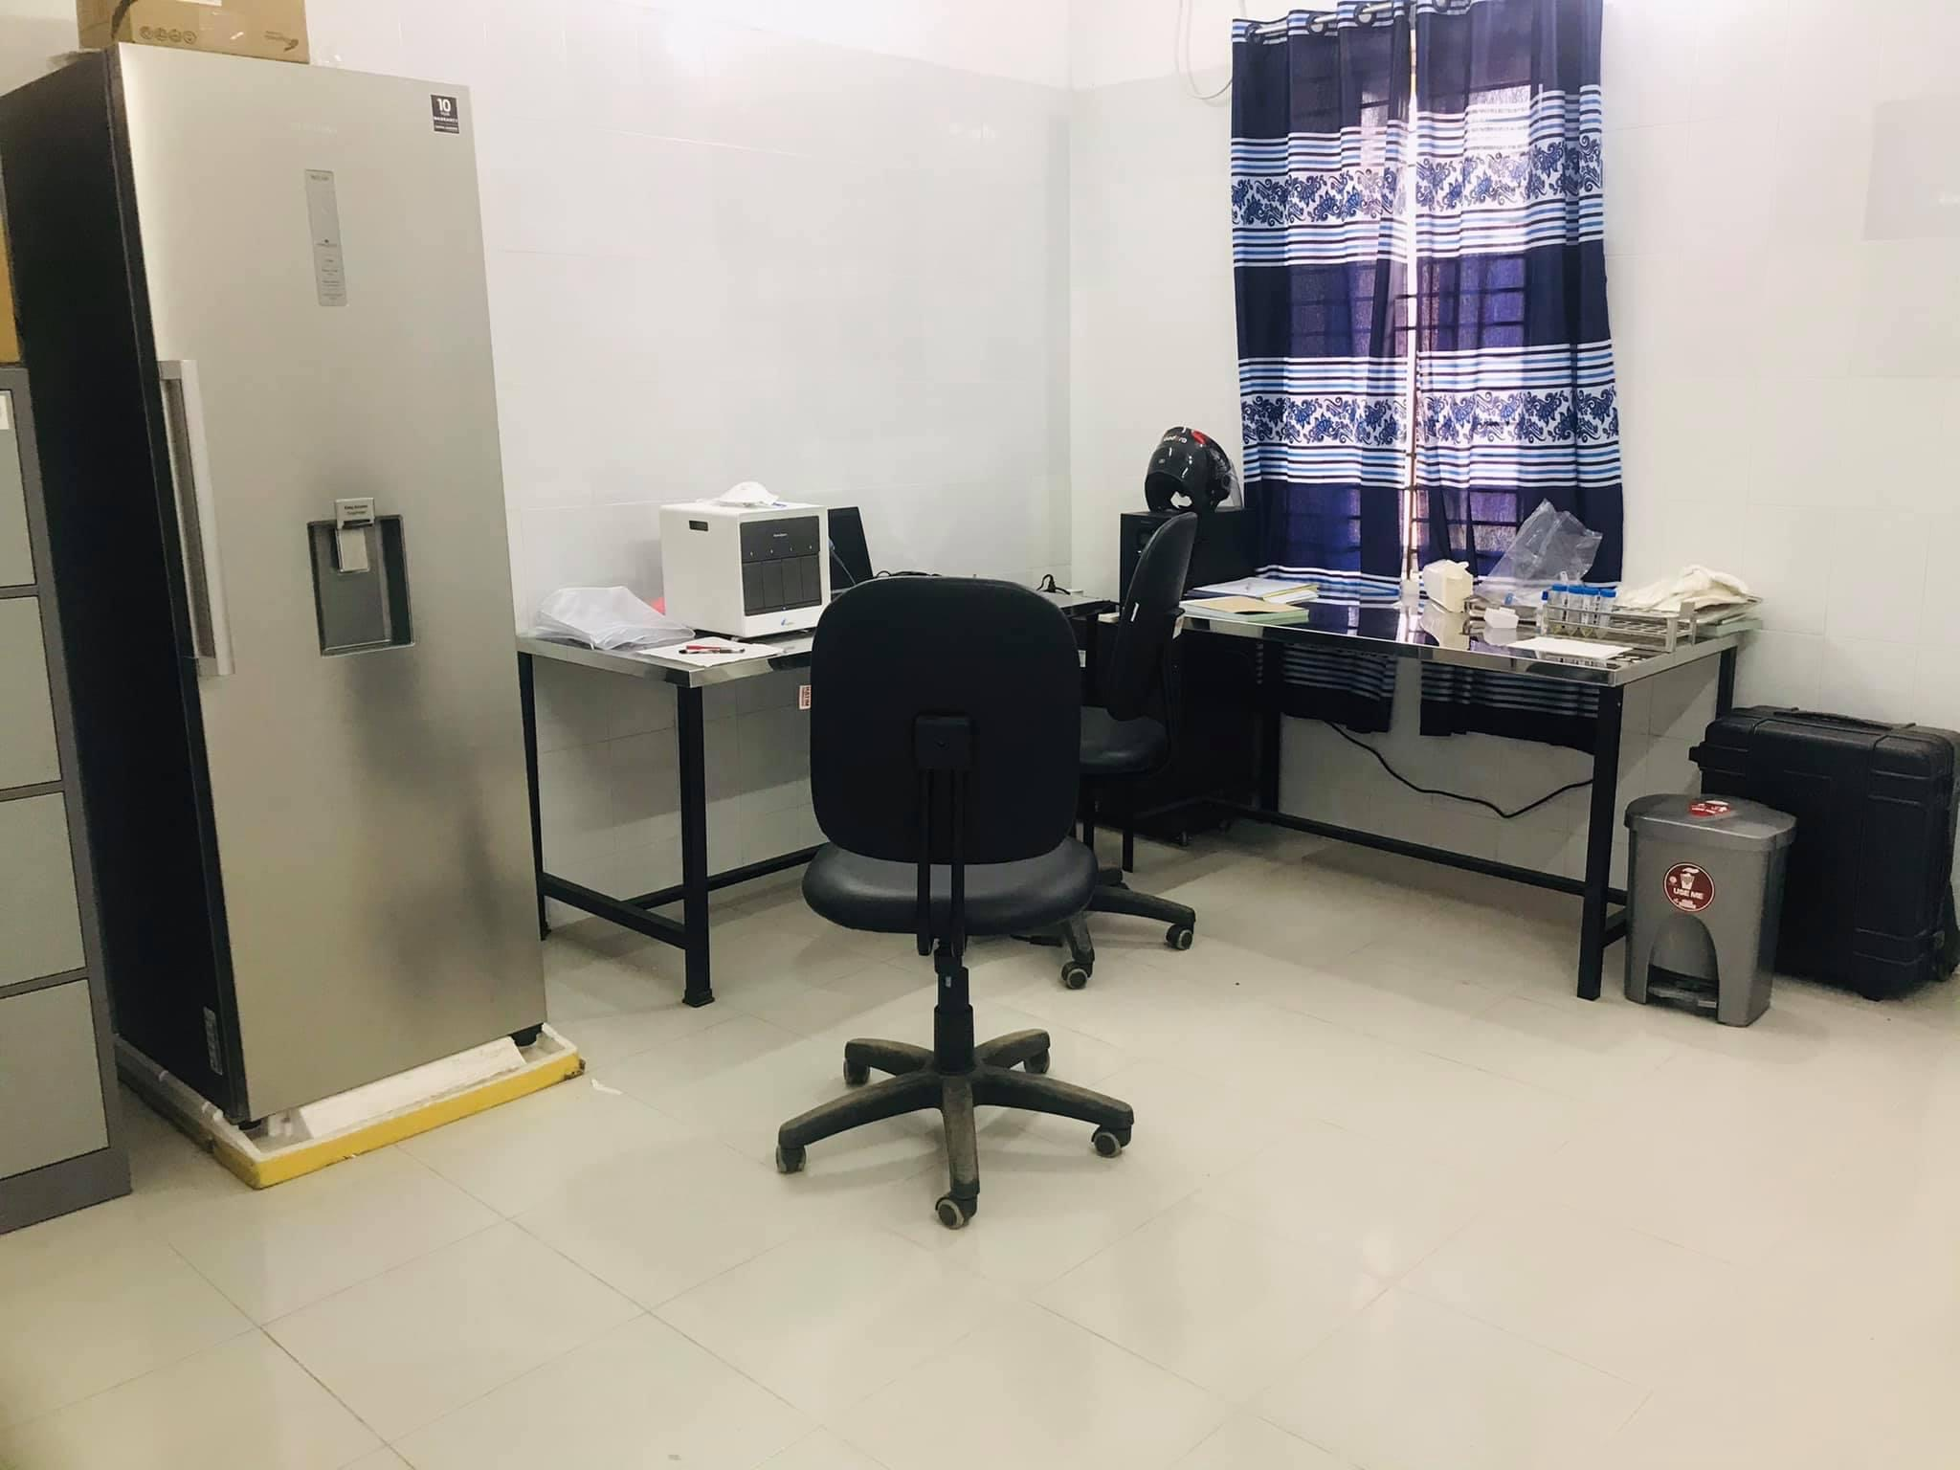
Gene X-pert and Dots corner added December 2021

Slide 21
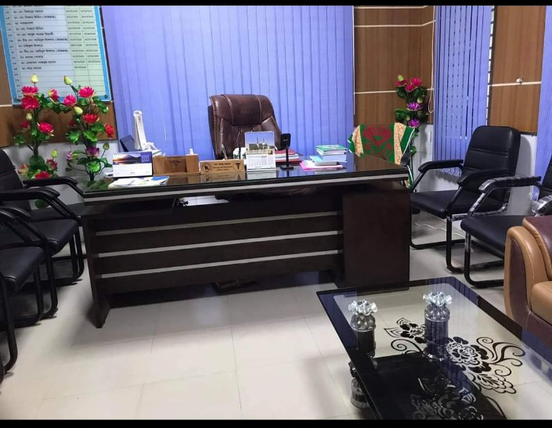
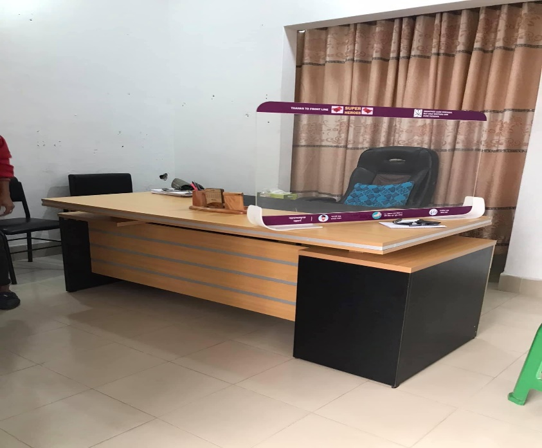
Well furnished UHFPO room(2020),RMO room(2021),EMO room(2022)

Slide 22

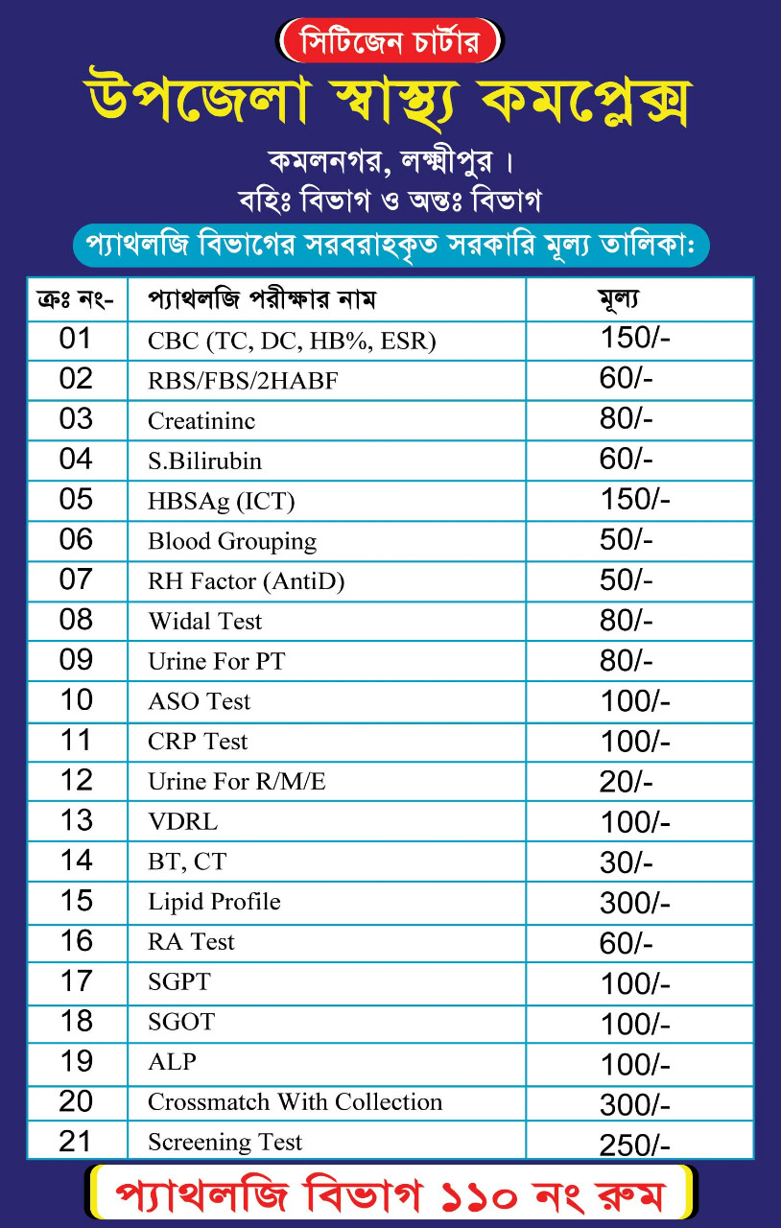
2022,july

Slide 23
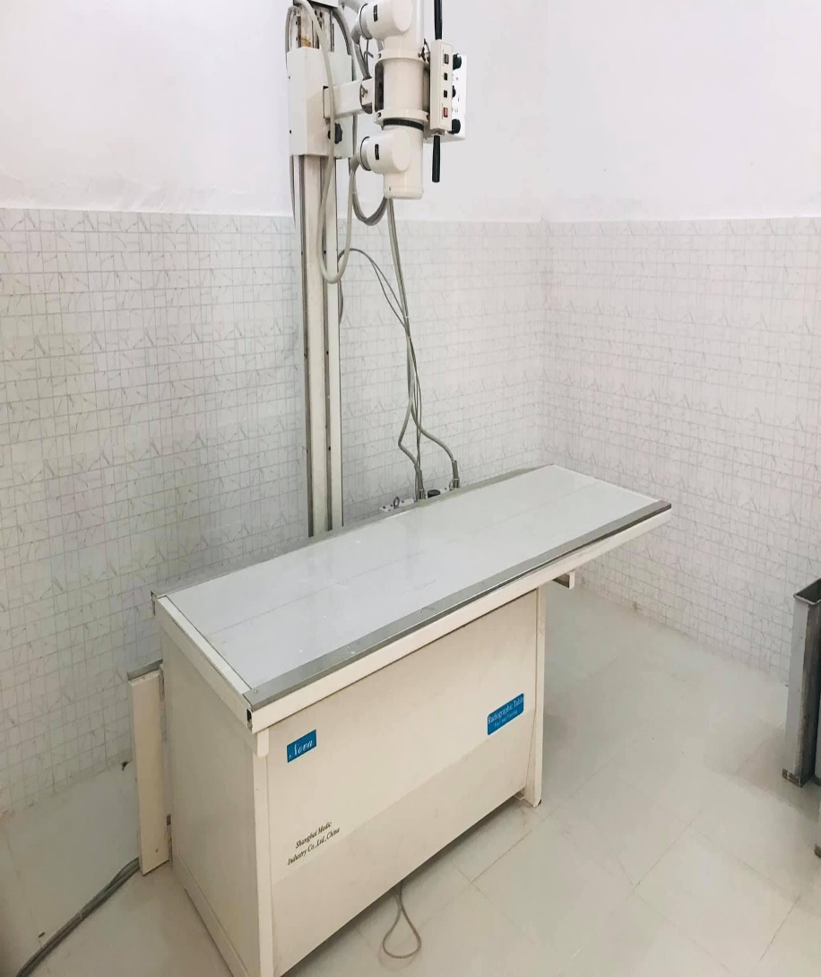
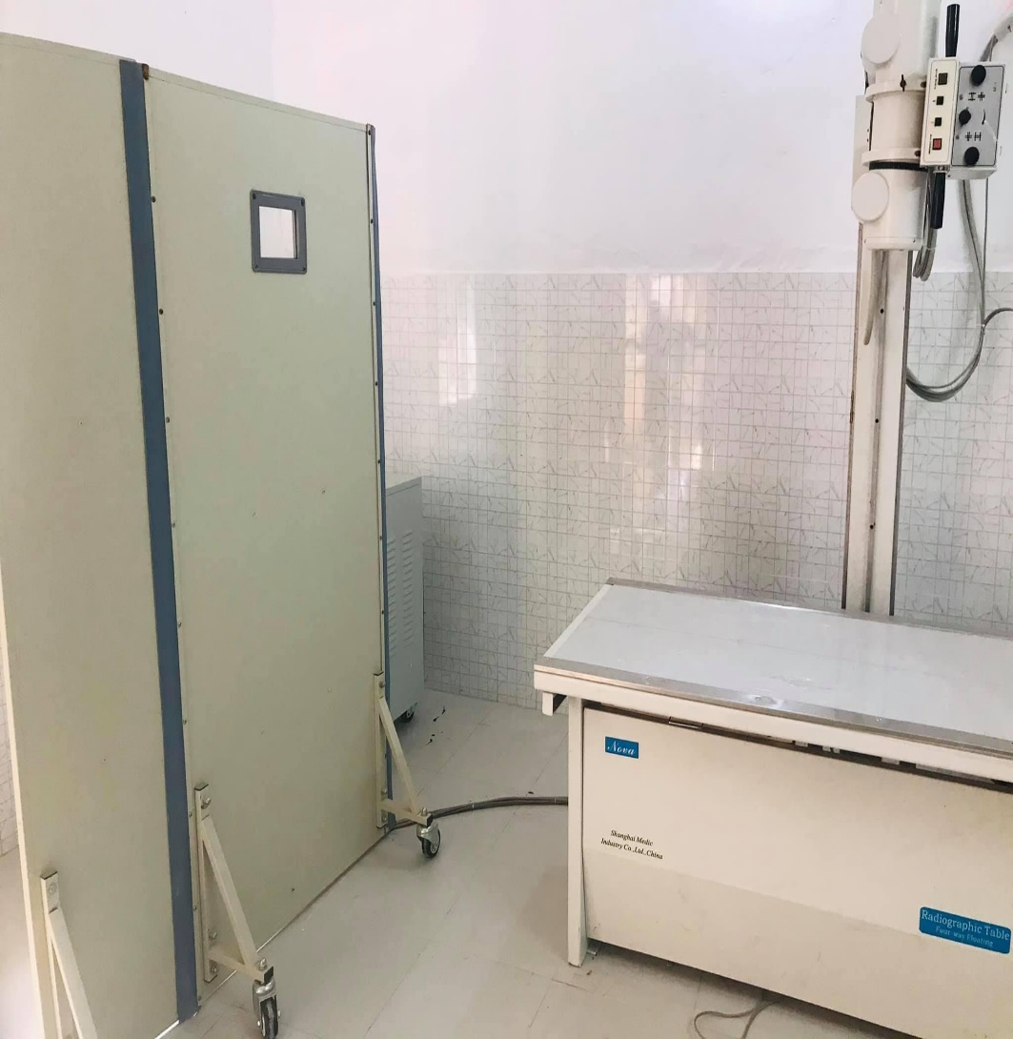
X-ray department added November 2020

Slide 24
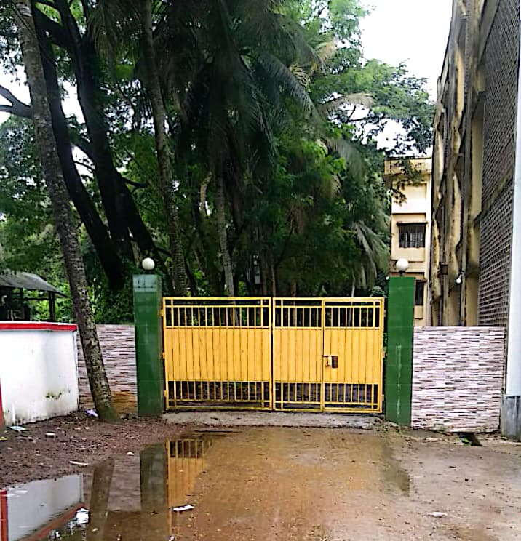
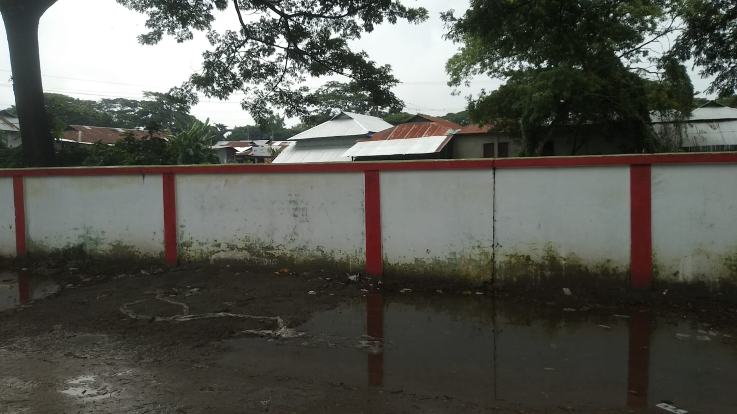
Hospital boundary wall and residential gate construction 2021

Slide 25
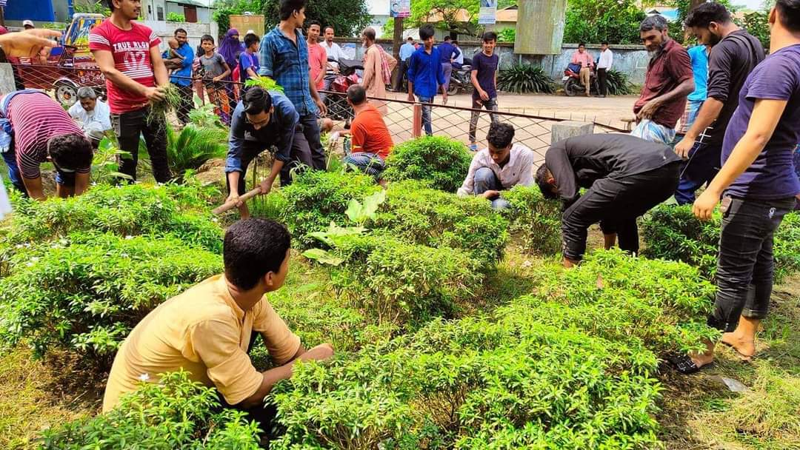
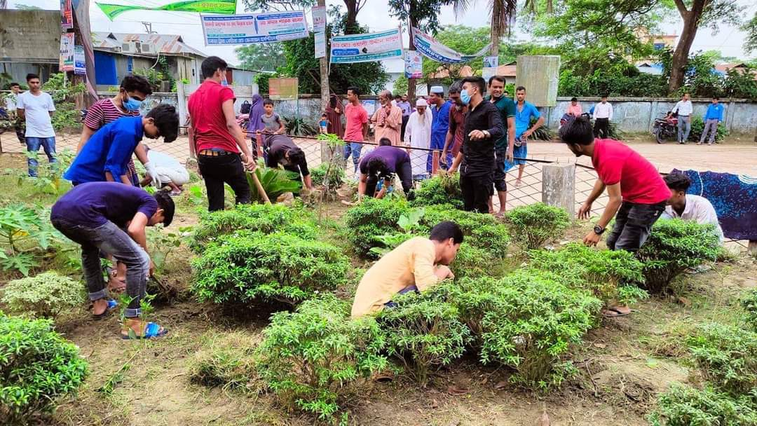
Gardening & Cleaning day,
Every Thursday.

Slide 26
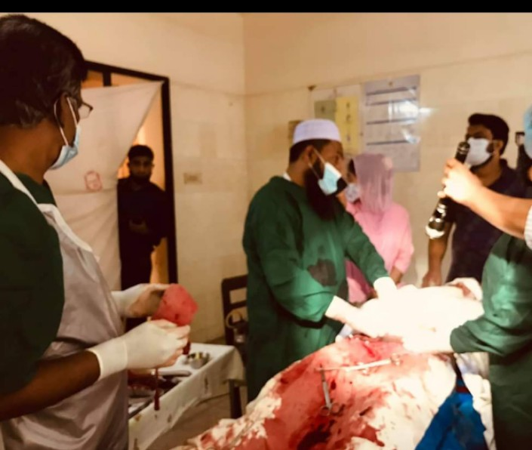
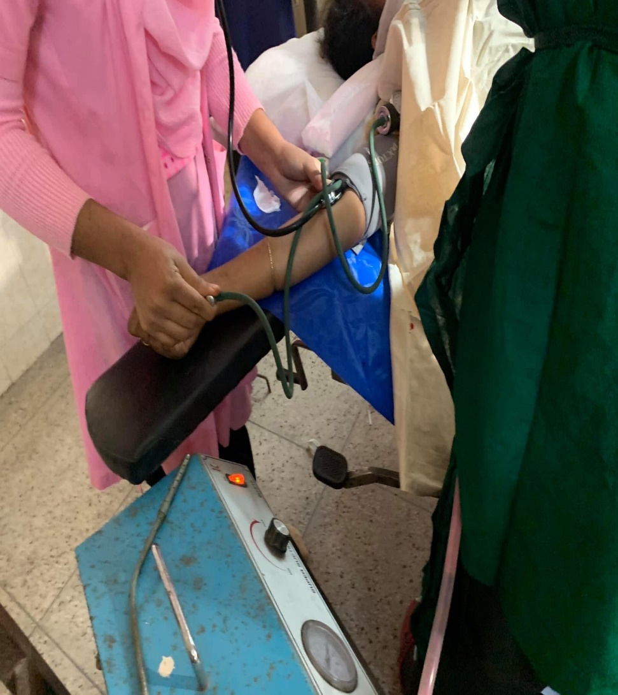
Upazila Health Complex kamalnagar, C section 2021

Slide 27
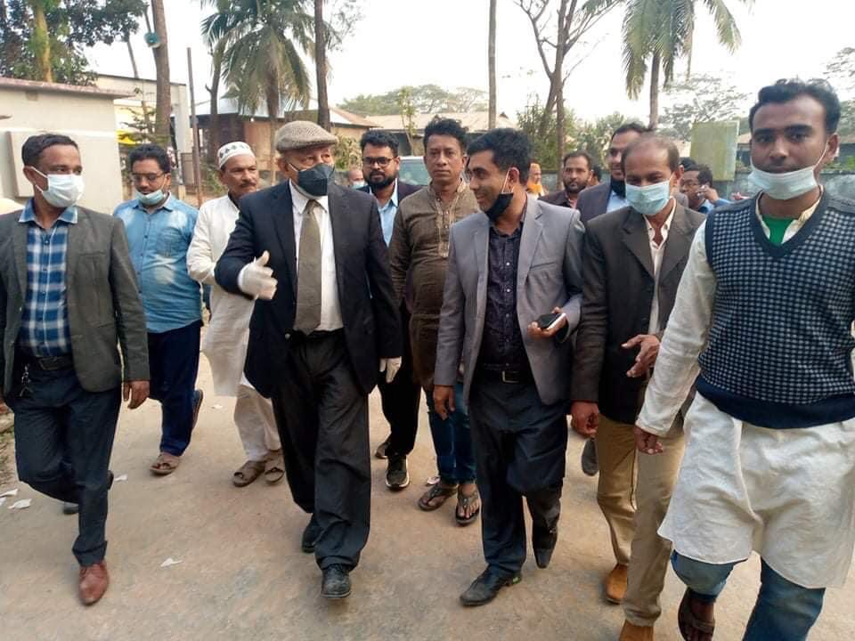
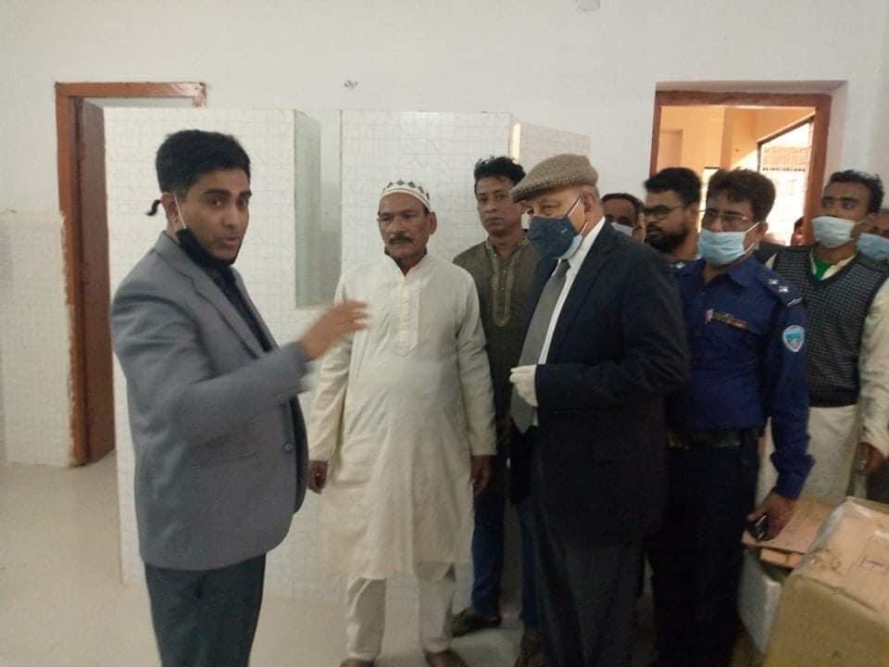
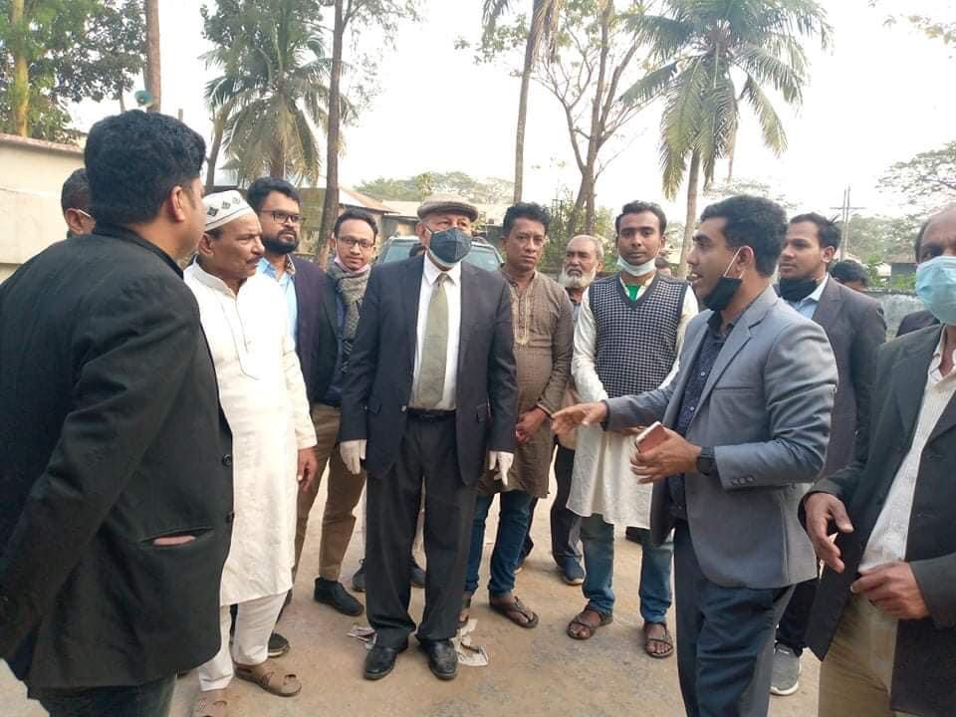
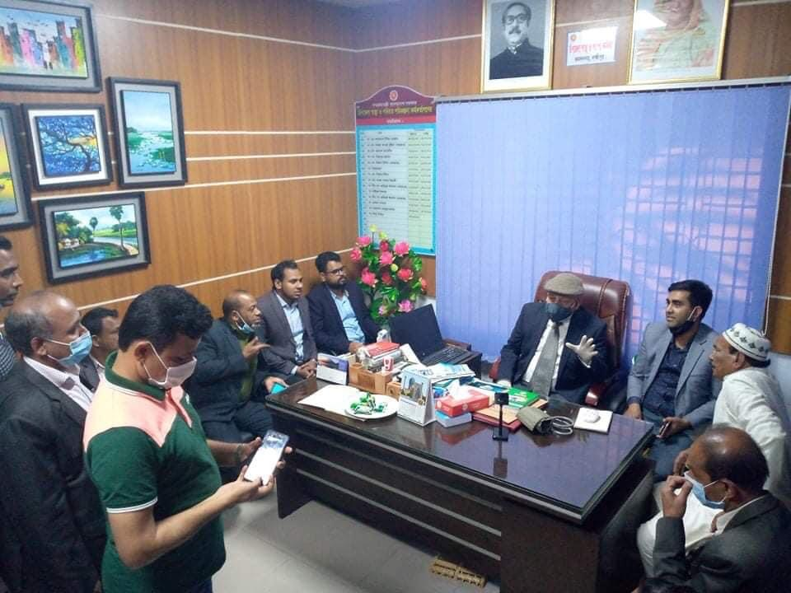
Inspection by MP,Major(Rtd) Abdul Mannan, 11 feb 2021

Slide 28
Upazila Health Complex kamalnagar, pathlogy visit CS Sir

Slide 29
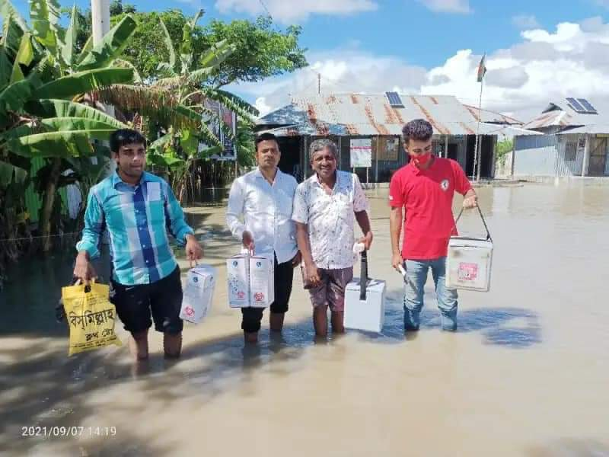
Upazila Health Complex kamalnagar, EPI Centre Risk

Slide 30
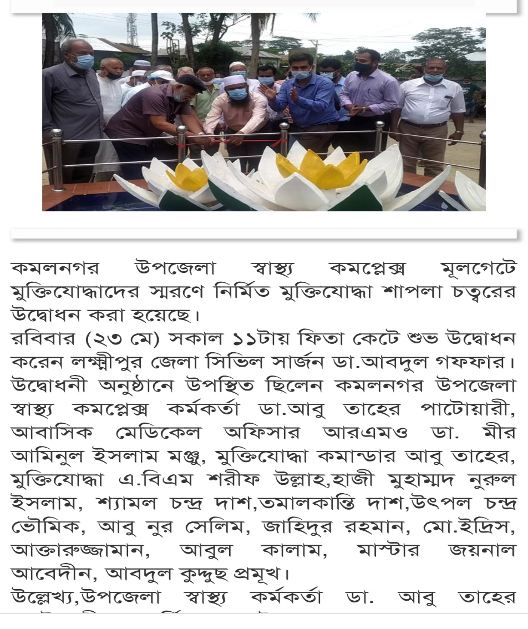
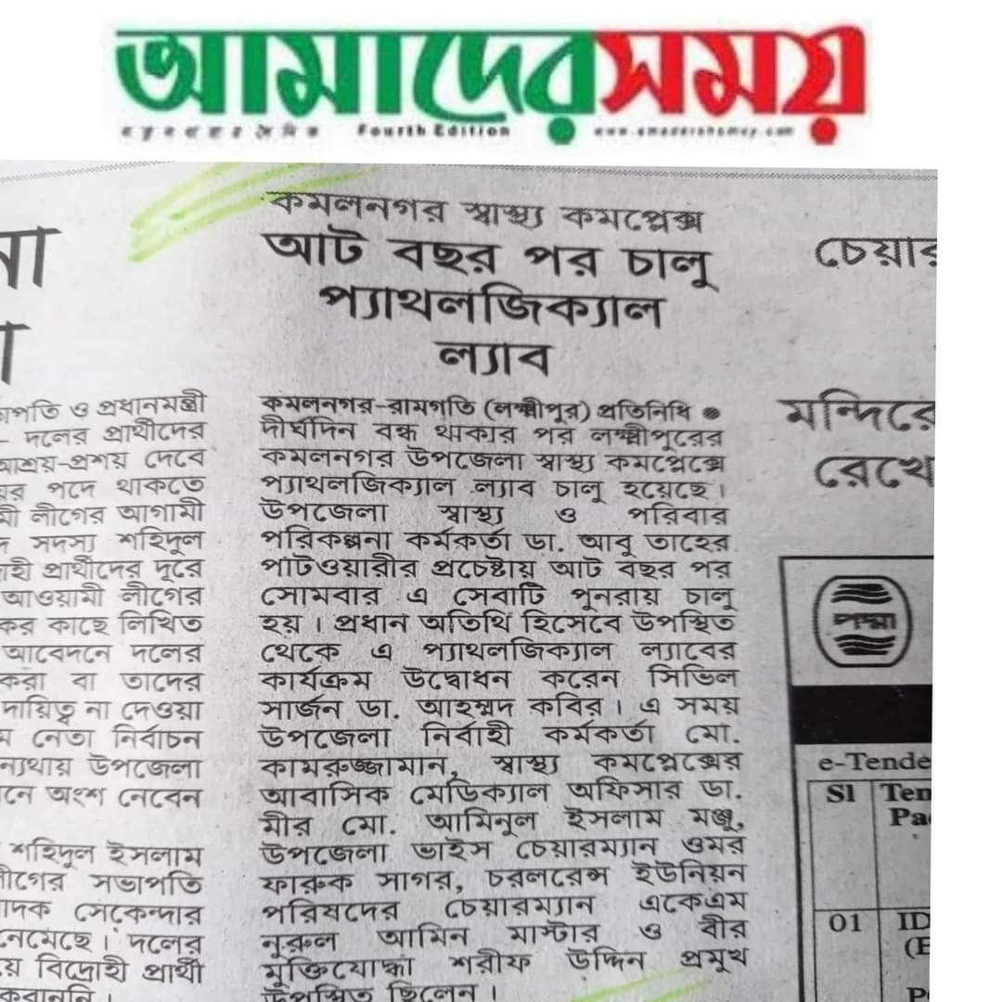
News paper coverage

Slide 31
Upazilla Health Complex kamalnagar, Lakshmipur.
Community Support
One IPS & delivery instruments financed by JICA for 10 delivery centers in each union.
Central oxygen system financed and organized by Upazila Parishad.
Blood donated by about 100 enlisted blood donors in emergency need (Transfusion of 165
bag F/blood are given in 2021,2022)
Fuel of Generator donated by MP and Upazilla Parishad .

Slide 32
Our achievements
Our upazila is near Meghna river and it is very hard to risk area.
#Our corona vaccine coverage-
> 1st dose-86.25%
>2nd dose-81.3%
# EPI coverage-99.99%

Slide 33
Challenges
1.Positive Change of the attitude of the service provider.
2. Fill up remaining 45% human resouces.and cancelletion of attachment post.
3. Construction and renovation of infrastructures specially
Store building & old building
4. UHFPO residence, Quarter and Dormitory construction.
5. Construction of River broken 4 CC.
6. Creation of post in favour of 50 bed.
-

Slide 34
Way Forward
1.Starting of VIA Corner.
2.Implementation of 5S KAIZEN-TQM.
3.Starting of Comprehensive EOC program.
4.Functioning of radiological activetes.
-

Slide 35


Slide 36
Our Co-ordinating function done
1. By regular physical monitoring and supervision
2. By using Technolgy
a. Messenger group
-Doctor messenger group
- EMO messenger group
-Nursing messenger group
- CHCP messenger group
- SACMO messenger group
- HI,AHI,HI messenger group
b. Mobile tracking system
3. By doing regular schedule meeting .

Slide 37
Hospital activities done by Following committees
Our every activity done by team building.
1. Hospital Management committee
2.Committee for Monthly co-ordinating meeting
3. committee for weekly meeting
4.Diet monitoing committee
5.Waste management committee
6. House rent and residential committee
7.Financial committee for MSR
8. Committee for health education and awareness
9. Store management committee
10. Fire fighting, rescue and safty committee
11.Anti-sexual harasement committee.
12. Social and cultural activities celebration committee
13. Audit committee.

